Slide 1



NLP
Research Design & Analysis
2025
Cross-platform public opinion tracking and analysis on Chinese social media
Reporter
TianFengshou
Time
2025.01
https://youtu.be/zEVeKPWI4XQ

Slide 2
1.
Introduction
Catalogue
2.
Literature Review
目录
3.
Research Methodology & Design
4.
Initial Findings
5.
Conclusion and Recommendations

Slide 3
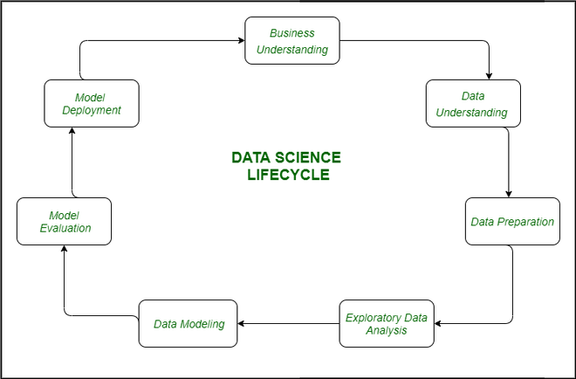
01
DESIGN
Introduction
DESIGN
POWERPOINT

Slide 4




Research Background
The rise of social media has made sentiment analysis crucial for understanding public opinion.
This study focuses on analyzing short text data from various social media platforms in China.

Slide 5
Problem Statement
No one has built a cross-platform crawler system yet, and all open source crawlers are single-platform crawlers. Poor data integration between platforms.
There are relatively few studies on sentiment analysis of short online texts, and the development has long been stuck in the large field of text
classification.
Existing algorithm research is limited to specific social media types and lacks cross-platform analysis.

Slide 6
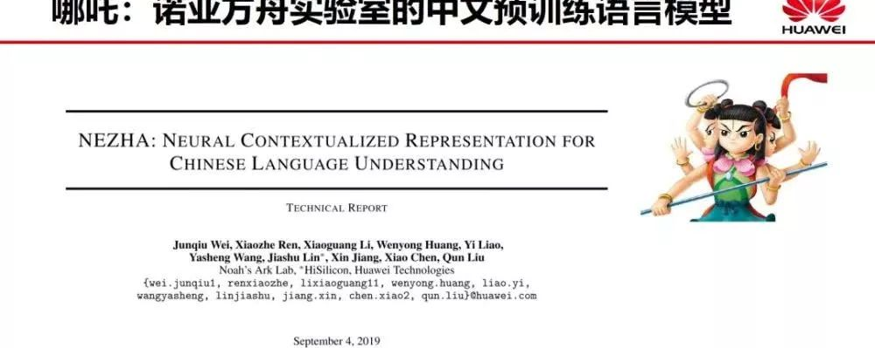
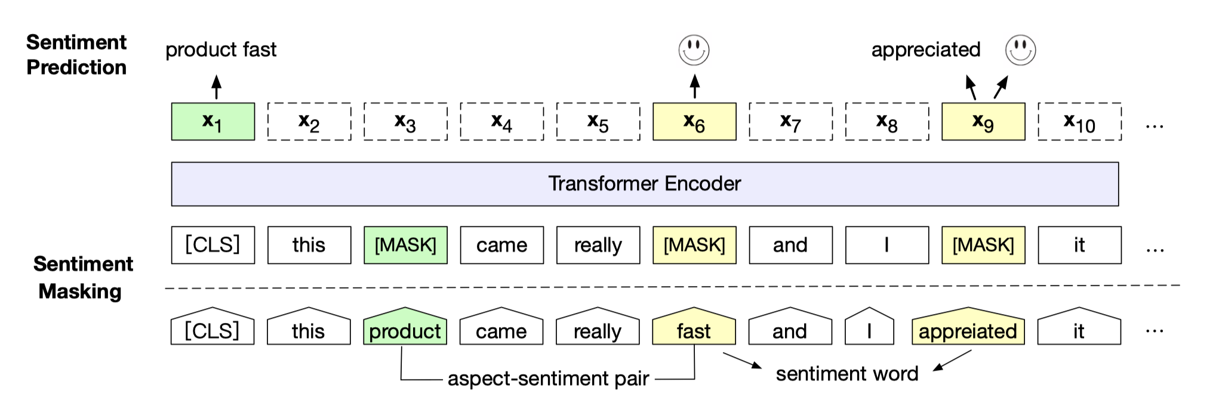
Research Objectives
Collect and analyze data from multiple social media platforms.
Study the effectiveness of different sentiment analysis models.
Build a deep learning model for efficient data analysis.

Slide 7

02
DESIGN
Literature Review
DESIGN
POWERPOINT

Slide 8
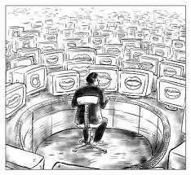
Public Opinion Communication Mechanism
User- generated content and platform algorithms shape public opinion.
So we should collect data,
Then observe public opinion from a more scientific perspective.

Slide 9

Short Text and Emotion Analysis
Challenges in processing short texts and advancements in sentiment analysis models.

Slide 10

Application of Key Technologies
Web Spider(Web Crawler)
LSTM, Transformer, and LLM models in public opinion analysis.

Slide 11

Social and Commercial Impact of Internet Rumors
The spread of rumors and their impact on society and businesses.

Slide 12
Contradiction between Government Decision-making and Public Expectations
DESIGN
POWERPOINT
The role of technology in bridging the gap between government actions and public expectations.

Slide 13

03
DESIGN
Research Methodology & Design
DESIGN
POWERPOINT

Slide 14

Data Science Life Cycle
Problem identification, data collection, preparation, analysis, modeling, evaluation, and deployment.
The definition actually refers to clarifying the goals and key issues of the project.
The core goal of this study is to perform sentiment analysis on text data of the same event on multiple social media. This goal can be broken down into two parts: data acquisition of the same event on different social media, and sentiment analysis of short online text data.

Slide 15
Data Science Life Cycle
The definition actually refers to clarifying the goals and key issues of the project.
The core goal of this study is to perform sentiment analysis on text data of the same event on multiple social media. This goal can be broken down into two parts: data acquisition of the same event on different social media, and sentiment analysis of short online text data.

Slide 16


Data Sources and Collection Methods
Data collected from Weibo, Bilibili, and Xiaohongshu using web crawlers.

Slide 17


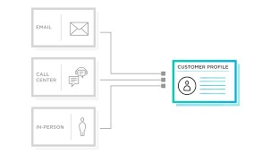
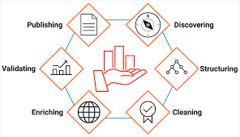
Data Preprocessing
Data cleaning, merging, and preparation for analysis.

Slide 18
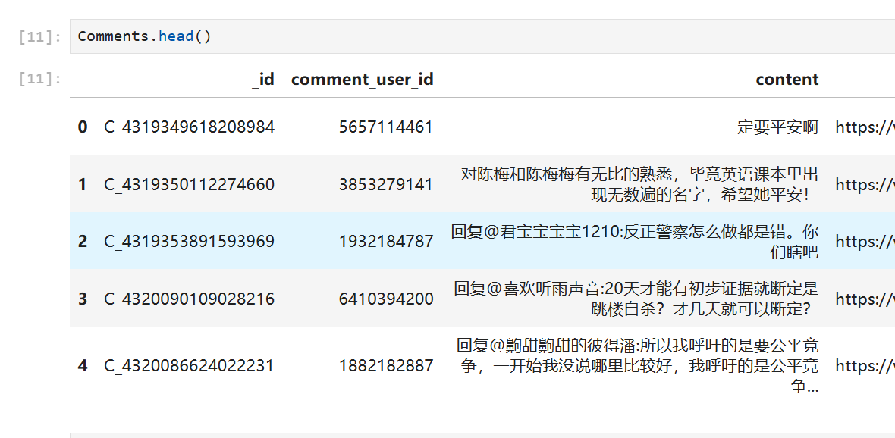
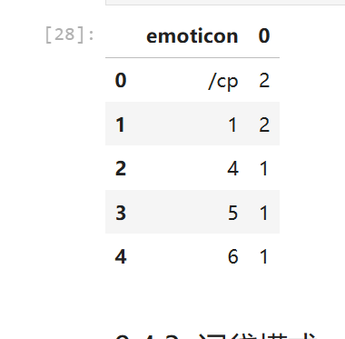
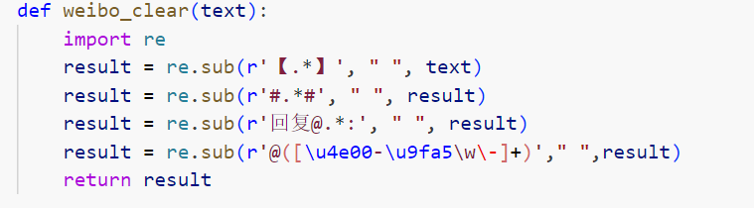
Data Preprocessing
This stage requires dealing with many practical difficulties, such as how to merge data from multiple platforms, how to build corresponding cleaning programs for dirty data from different platforms, the issue of timestamps, how to associate data from different platforms according to events, how to remove erroneous data found in searches, etc.

Slide 19
04
DESIGN
Initial Findings
DESIGN
POWERPOINT

Slide 20
Data Exploration
Text processing, statistical analysis, visualization
AND
Statistical analysis of emoticons and word segmentation.

Slide 21
Data Exploration
Natural language processing has many special tasks to do.
For example:
Quantity(word), frequency(word), stop words,
new word discovery problems inherent in word segmentation problems (use model to solve them directly without much description),
and word clouds

Slide 22
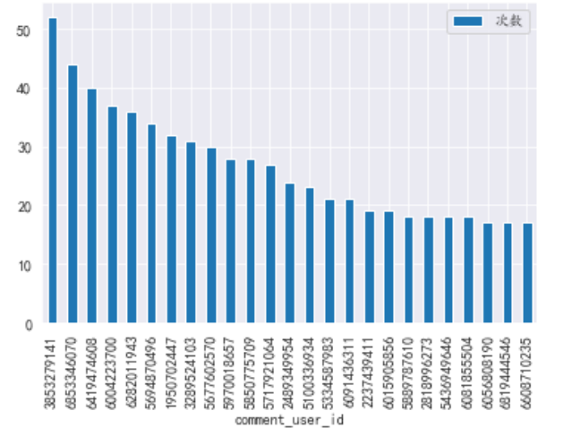

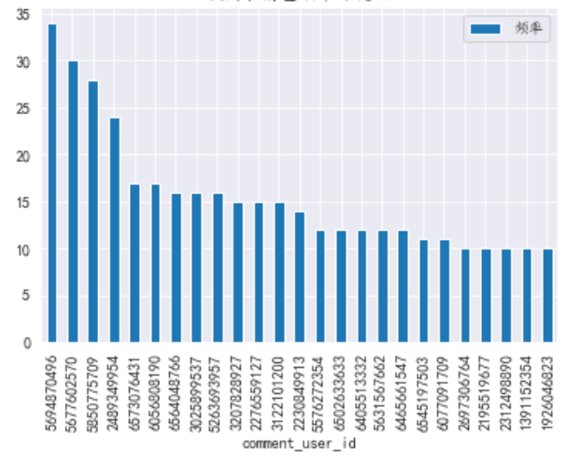

Data Exploration

Slide 23
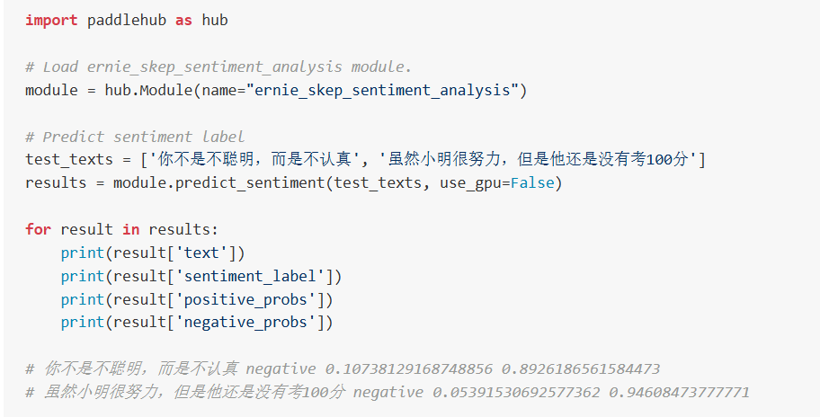
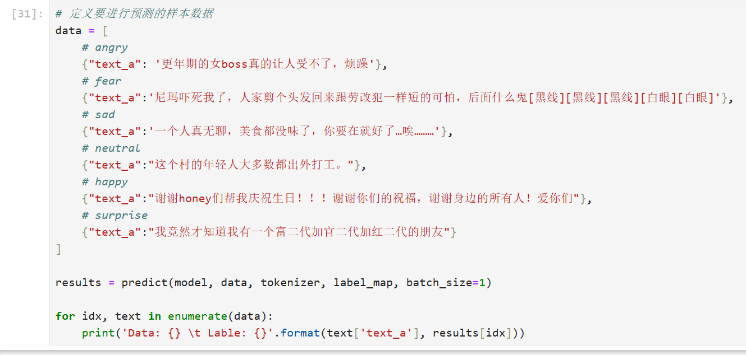
Sentiment Analysis
01
There are many solutions for sentiment analysis,
such as
(1) CRF
(2) LSTM
(3) CNN
(4) Nezha
(5) DistilBERT
Notes:
The final accuracy rate increased from 91% to 93%.

Slide 24
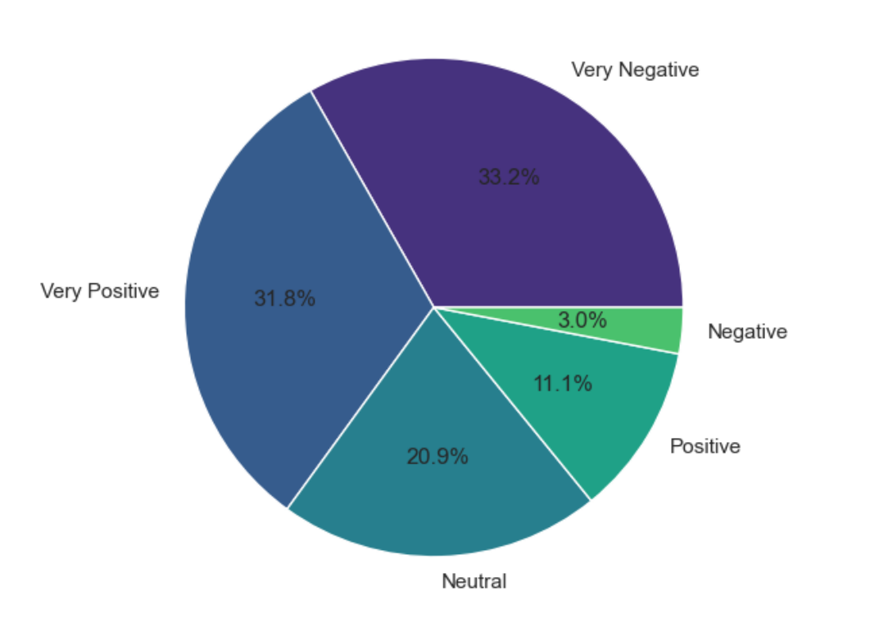
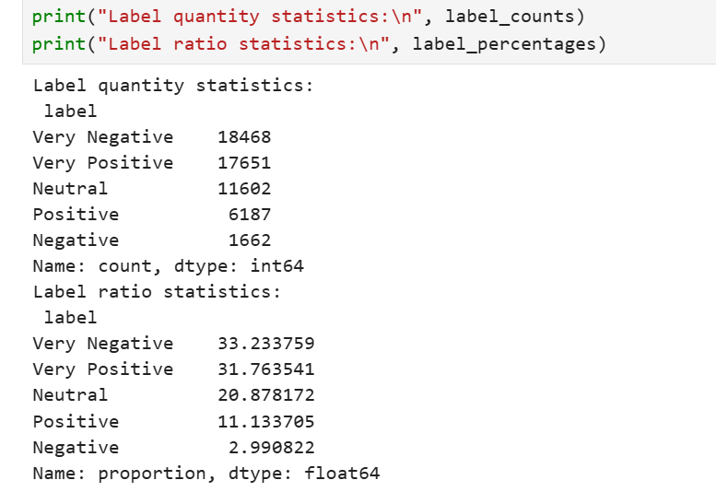
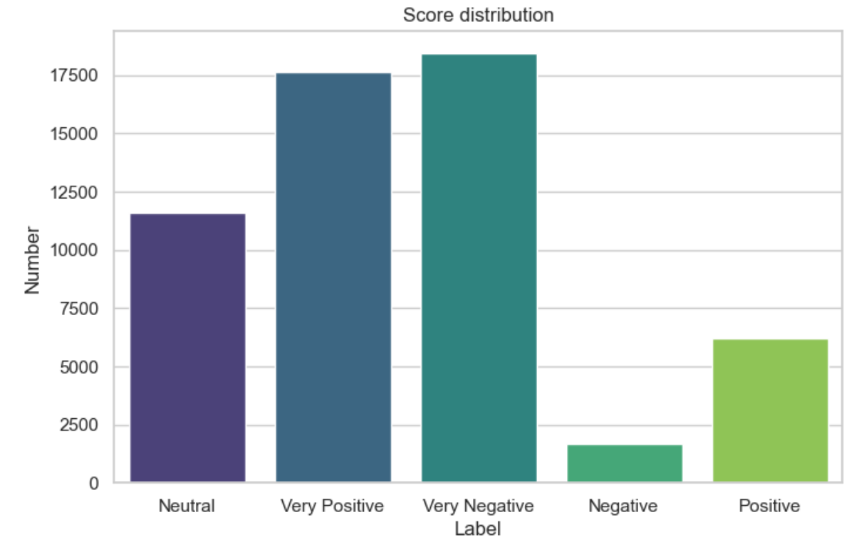
Sentiment analysis and statistical analysis and visualization
02

Slide 25
05
DESIGN
Conclusion and Recommendations
DESIGN
POWERPOINT

Slide 26

Summary
The three core tasks of crawler, multi-platform data merging, and sentiment analysis model have basically achieved the design goals.

Slide 27

Future Works
(1) Improve data acquisition capabilities.
(2) Improve the predictive ability of sentiment analysis models.
(3) Study the propagation mechanism.

Slide 28
Bye
Research Design & Analysis
2025
Thanks
Reporter
TianFengshou
Time
2025.01

